Slide 1
CHAPTER 1
FUNCTIONS AND MODELS

Slide 2
CONTENTS
1.1 Four way to represent a function
1.2 Model and Curve Fitting
1.3 New Functions from Old Functions
1.4 Graphing Calculators and Computers
1.5 Exponential Functions
1.6 Inverse Functions and Logarithmic Functions
1.7 Parametric Curves

Slide 3
1.4 GRAPHING CALCULATORS AND COMPUTERS
In this section we use MAPLE, a Computer Algebra Program created by University of Waterloo, Ontario, Canada to draw the graphs of several functions,
and apply this to solve some related problems

Slide 4
Let Ox be an axis with a chosen unit vector i.
Then a real number a is represented by a point A on Ox such that the vector OA is equal to ai. a is the coordinate of A.
i
A
O
a
Now if a is a rational number, then the point A can be located accurately on Ox by geometric construction. In practice, however, it is convenient to use decimal representation of a.
e.g. the rational number 123/1000 is represented with 3 decimal digits 0.123 .

Slide 5


However, some rational numbers,
such as 10/3 and 5/33 can only be represented with an infinite number of digits with a repeated pattern:
We write:
Irrational numbers are represented with infinite number of digits without any repeated pattern.
A number a with infinite decimal representation can always be truncated to a certain number of decimal digits to give an approximation of a by a rational number
Thus 5/33 can be approximated by 0.1515
with error < 10^{–4}

Slide 6
The graph of a function will be a curve in the plane with two perpendicular coordinate axes, where the x-coordinate and the y-coordinate of a point are approximated as above
Viewing rectangle: is a rectangular portion of the graph displayed by a graphing calculator or computer
y=d
(b,d)
(a,d)
x=a
[a,b]x[c,d]={(x,y) / a≤x≤b, c≤y≤d}
x=b
(a,c)
y=c
(b,c)

Slide 7
Example: draw the graph of the function f(x) = x² + 3 in the following viewing rectangle:
(a) [-2,2]x[-2,2]. We get empty plot since the values of f(x) for x in [-2,2] lies ouside of [-2,2]
2
-2
2
-2

Slide 8
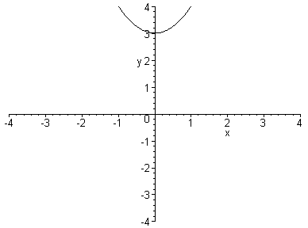
Example: draw the graph of the function f(x) = x² + 3 in the following viewing rectangle:
(b) [-4,4]x[-4,4]. Only a small part of the graph lies inside of the viewing rectangle
4
-4
4
-4

Slide 9
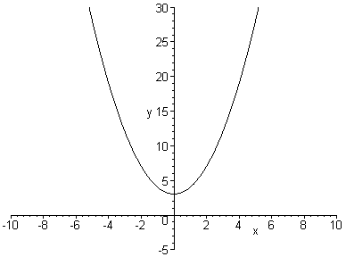
Example: draw the graph of the function f(x) = x² + 3 in the following viewing rectangle:
(c) [-10,10]x[-5,30]. A large part of the graph lies inside of the viewing rectangle

Slide 10
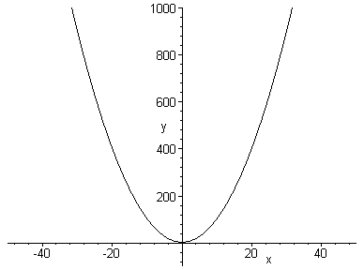
Example: draw the graph of the function f(x) = x² + 3 in the following viewing rectangle:
(d) [-50,50]x[-100,1000]. A larger part of the graph lies inside of the viewing rectangle
-50
50
-100

Slide 11
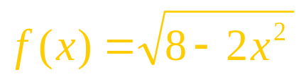
Example: determine an appropriate viewing rectangle and using it to graph the function:
Solution: f(x) is defined when:
8 – 2 x² ≥ 0 ⇔ 2x² ≤ 8 ⇔ x² ≤ 4
⇔⏐x⏐ ≤ 2 ⇔ –2 ≤ x ≤ 2
Therefore domain(f) = [-2,2]. Also

Slide 12
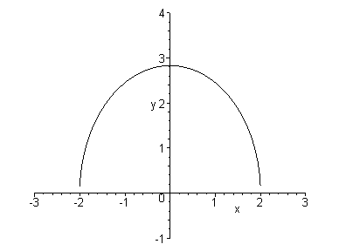
The graph of f is sketched in the viewing rectangle [-3,3]x[-1,4]

Slide 13
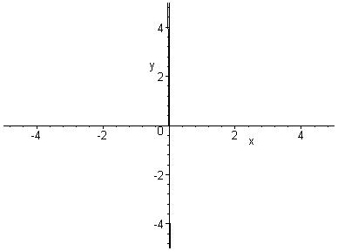
Example: graph the function y = x³ – 150x
Solution: domain(f) = R so we have to choose appropriate viewing rectangles
(a) [-5,5]x[-5,5]: the graph is so narrow vertically that it blends with the y-axis

Slide 14
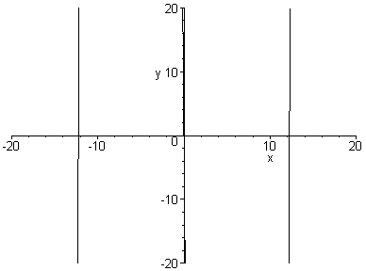
(b) [-20,20]x[-20,20], it seems that the graph consists of vertically lines.
This is impossible. Therefore we need more in the vertical direction.

Slide 15
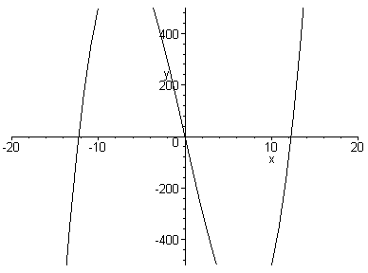
(c) [-20,20]x[-500,500], the graph as displayed is better. However to get more complete display, we need even more in the vertical direction.

Slide 16
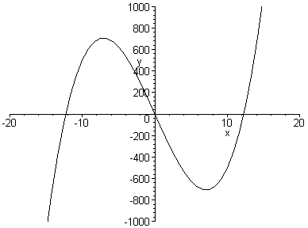
Conclusion: it is important to choose the appropriate viewing rectangle
(d) [-20,20]x[-1000,1000], the graph as displayed is more or less complete: we get all main features of the function.

Slide 17
Example: graph the function f(x) = sin 50x
We will use MAPLE to draw the graph.
With the viewing rectangles as in the Textbook, the displayed graphs look differently.
Moreover, by changing the value of the parameter numpoints of MAPLE, we get very weird looking graphs.
Following are some examples.

Slide 18
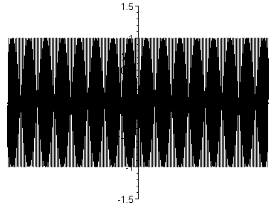
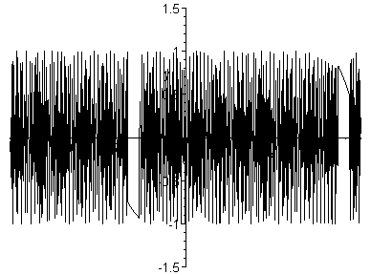
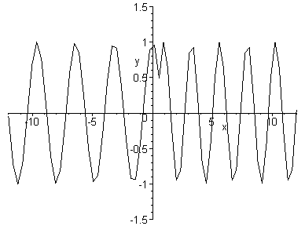
Viewing rectangles [-12,12]x[-1.5,1.5]

Slide 19
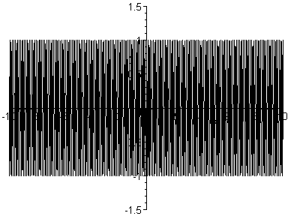
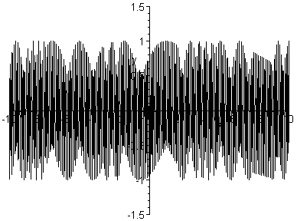
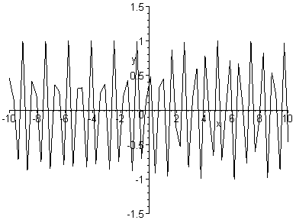
Viewing rectangles [-10,10]x[-1.5,1.5]

Slide 20
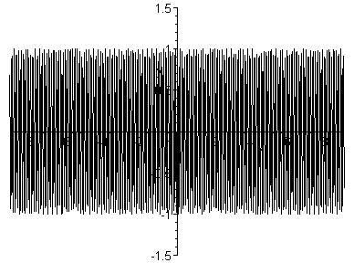
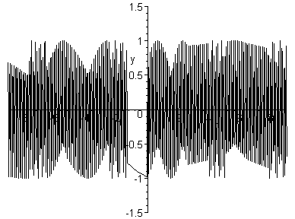
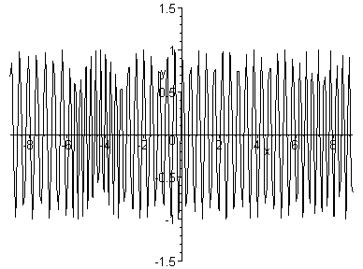
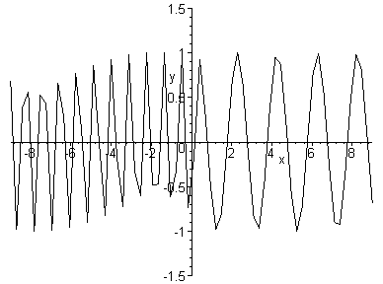
Viewing rectangles [-9,9]x[-1.5,1.5]

Slide 21
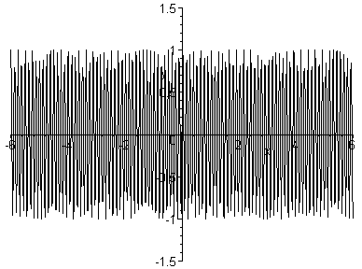
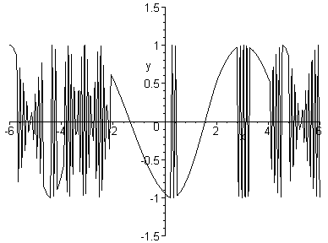
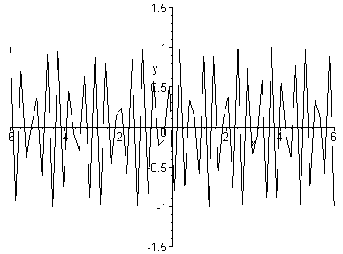
Viewing rectangles [-6,6]x[-1.5,1.5]

Slide 22
Let us find the period of sin 50x. Since sinx has period 2π, and the graph of y = sin 50x is compressed horizontally by a factor of 50, the period of y=sin 50x is
Therefore very large values of x would show a huge amount of oscillations.
When MAPLE plots a curve, it join the consecutive points by line segments.
If there are so many oscillations, it may miss many important intermediate values and give unexpected views for the graph as shown in the foregoing examples

Slide 23
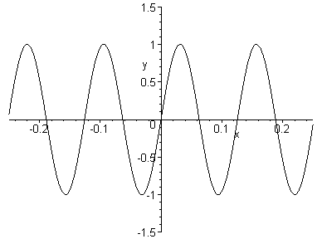
On the other hand, if we let x taking small values, the graph only has few oscillations and we get more correct looking view
Viewing rectangles [-0.25, 0.25]x[-1.5, 1.5]

Slide 24
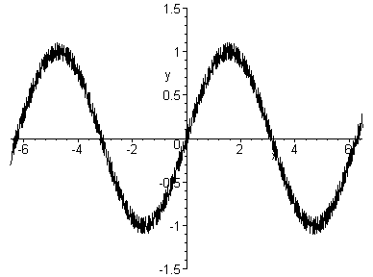
Example: graph the function
With the viewing rectangles [-6.5, 6.5]x[-1.5, 1.5] the graph looks like that of sinx with some bumps

Slide 25
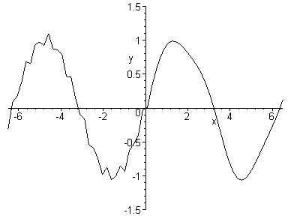
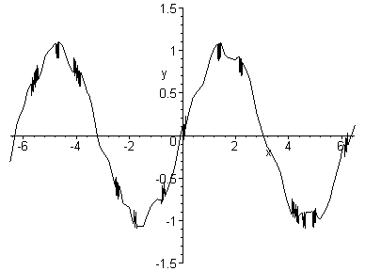
With the same viewing rectangle but when the values of the parameter numpoints decreases, the number of bumps also decreases

Slide 26
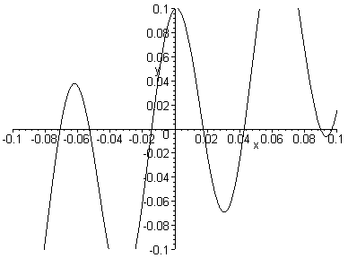
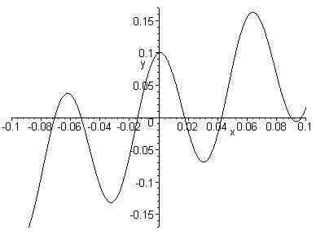
Zooming in, we can see clearly the shape of these bumps
[-0.1, 0.1]x[-0.1, 0.1]
[-0.1, 0.1]x[-0.17, 0.17]

Slide 27
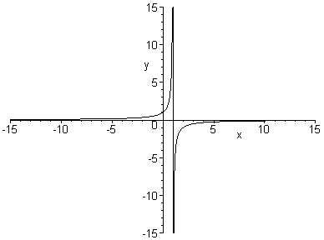
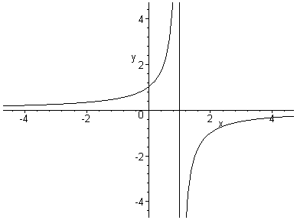
Example: draw the graph of the function
[-15, 15]x[-15, 15]
[-4.7, 4.7]x[-4.7, 4.7]
With MAPLE, no matter how small the interval is, the segment on the line x=1 of the graph cannot be removed

Slide 28
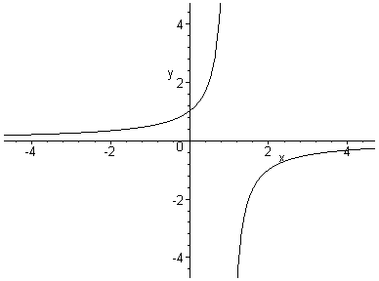
To remove that segment we should set the parameter discont to true.
The meaning of this parameter will be explained in Chapter 2

Slide 29
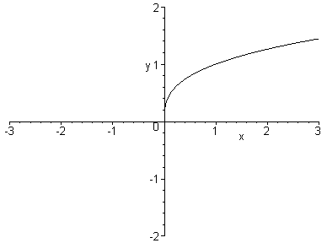
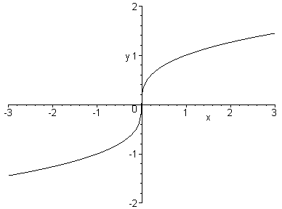
Example: draw the graph of the function
MAPLE plots the incorrect curve on the left because it computes cubic roots using logarithm which is not defined for x < 0. To have the correct graph on the right
we use the following function:

Slide 30
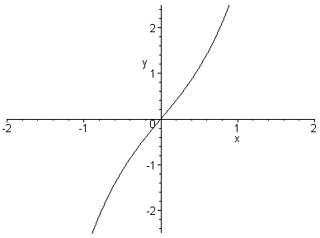
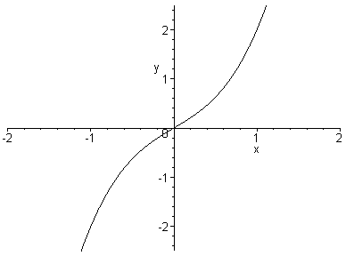
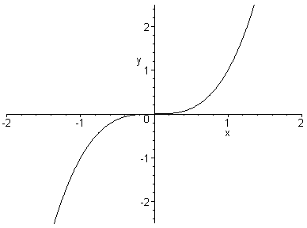
Example: graph the family of functions y = x³ + cx, c = 2, 1, 0, -1, -2.
c=2
c=1
c=0
For c>0, the graph increases from left to right without any maximum or minimum points.
For c=0 the curve is flat at the origin

Slide 31
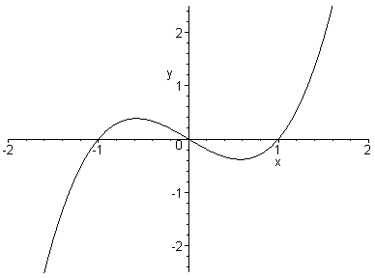
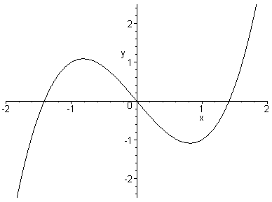
c=-1
c=-2
For c<0, the curve has a maximum or minimum.
As |c| increases, these points are further away from the x-axis

Slide 32
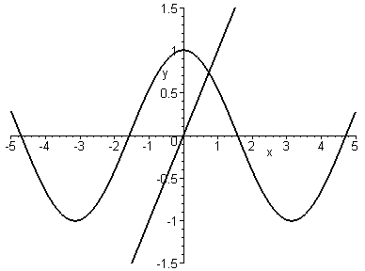
Example: find the solution of the equation cosx = x correct to two decimal places.
Solution: the solution is the x-coordinate of the intersection of two curves y = cosx and y = x.
Graphing two curves in the viewing rectangle [-5,5]x[-1.5,1.5] we see that there is a solution lying in the interval [0,1]

Slide 33
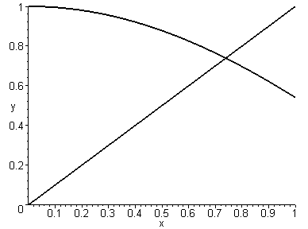
Zooming in the viewing rectangle [0,1]x[0,1] we see that the solution lies between 0.7 and 0.8

Slide 34
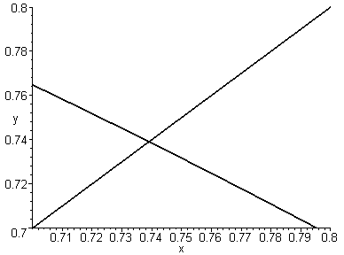
Further zooming in the rectangle [0.7,0.8]x[0.7,0.8] we see that the solution is 0.74 up to 2 decimal places

Slide 35
The solution is 0.74 up to 2 decimal places
MAPLE also provides the command fsolve of to obtain the solution x = 0.7390851332 up to 10 decimal places:
>fsolve(cos(x)=x);
0.7390851332

